Slide 1
Hi，tell me how are you feeling today？

Slide 2

FACELOOK
--Facial Emotion Recognition

Slide 3


Team Member ( Group 13 )
01
WU JUNXIAN A0231293L
02
YING ZHUOZUO A0231534N
03
WANG KEDI A0231356L
04
ZONG JIULIN A0231352U

Slide 4



Presentation Contents
Progress
What we have done so far
Overview
Background & Objectives
Scope
What is contained in our Project

Slide 5

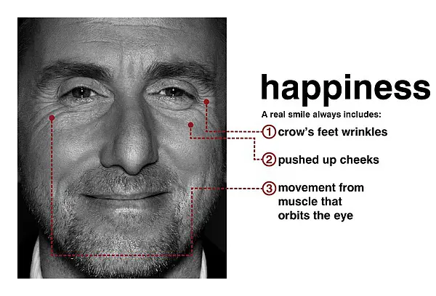
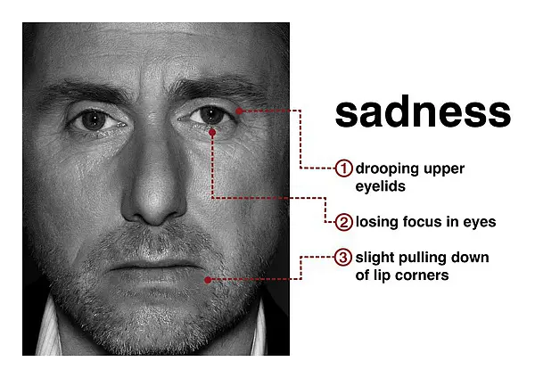
Project Background & Objectives
Facial expression is one of the most crucial way to transfer emotional information and coordinate interpersonal relationships within all kinds of emotional expressions. And facial expression recognition refers to the selection of facial expression states from static photos or video sequences to recognize people’s emotional and psychological changes.
If we get someone’s emotional information, we are able to understand his psychological condition, analyze his real-time reaction, or roughly predict his behavior. Also, we can do some further research or take some action based on it.
J. Yi, Y. Sima, M. Zhou and J. Yang, "Facial Expression Sequence Interception Based on Feature Point Movement," 2019 IEEE 11th International Conference on Advanced Infocomm Technology (ICAIT), 2019, pp. 58-62

Slide 6
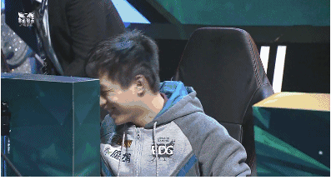
Project Background & Objectives
But some expression can be misleading. Humans are masters at hiding emotions. For social or psychological considerations, people will control their expressions.
Even your joke is not so funny, your friend will laugh to cater to you.
Some criminal suspects can be very calm when pleading not guilty.
Some people will even lie to their doctors to hide some symptoms that they are too shy to speak out.

Slide 7

Project Background & Objectives
The concept of micro-expression was first proposed by Haggard and Isaacs in 1966. Unlike "traditional" facial expressions which can be consciously controlled, micro-expression is caused by psychological inhibition of unconscious contraction of lower muscles. The micro-expression has the characteristics of short duration (1/25 to 1/5s) and low action intensity, so it is difficult for humans to capture such information (recognition accuracy rate only 40%). But it is crucial that it can be used for lying detection, providing compelling evidence of lies. It can also be used in the treatment process by psychologists to accurately grasp patient's emotions to make a better diagnosis.
M. Verma, S. K. Vipparthi, G. Singh and S. Murala, "LEARNet: Dynamic Imaging Network for Micro Expression Recognition," in IEEE Transactions on Image Processing, vol. 29, pp. 1618-1627, 2020

Slide 8
Project Background & Objectives
Our objective is to combine facial expression and micro-expression together, to recognize people’s emotion in photos or videos.
For facial expression, we will construct an emotion recognition model according to the training data. Predict selected test data and identify the state of the face from seven emotions.
['happy', 'angry', 'disgusted', 'neutral', 'fearful', 'sad', 'surprised’].
For micro-expression, we try to detect whether micro-expressions are present in a video stream and mark the onset peak and end of micro-expressions. And we will do some further precise judgement of emotion like whether a person is truly happy when he smiles.
Hongcheng Wang and Ahuja, "Facial expression decomposition," Proceedings Ninth IEEE International Conference on Computer Vision, 2003, pp. 958-965 vol.2

Slide 9
01
Facial Expression
FaceLook
02
Scope
Facial Micro-Expression
03
Multimodal Emotion recognition

Slide 10


Facial Expression

Slide 11
Background
What is facial expression?
Facial expression is the result of one or more actions or states of facial muscles. These movements express the individual's emotional state to the observer. Facial expression is a form of nonverbal communication. It is the main means of expressing social information between humans, but it also occurs in most other mammals and some other animal species .
2. Why is facial expression important?
Expression is an emotional index projected by human and other animals from the appearance of the body .
3. What are the basic expressions of human?
In 1971, the research of psychologists Ekman and Friesen first proposed that human beings have six main emotions, and each emotion reflects a unique psychological activity of a person with a unique expression. These six emotions are called basic emotions and are composed of anger, happiness, sadness, surprise, disgust and fear .
Wang, B. (2021). [Machine Learning] Experimental notes - emotion recognition. Retrieved 28 August 2021, from https://blog.csdn.net/walilk/article/details/58709611
Tarnowski, P., Kołodziej, M., Majkowski, A., & Rak, R. J. (2017). Emotion recognition using facial expressions. Procedia Computer Science, 108, 1175-1184
Facial expressions play an important role in emotion recognition and are used to recognize people in non-verbal communication. They are very important in daily emotional communication, second only to tone. They are also indicators of emotion, allowing a person to express an emotional state. People can immediately recognize a person’s emotional state. Therefore, information about facial expressions is usually used in automatic systems for emotion recognition.
The human face is the most exposed part of the body, allowing the use of computer vision systems to analyze facial images to identify emotions. Changes in lighting conditions and head position are the main factors that affect the quality of emotion recognition systems that use cameras. Methods based on two-dimensional image analysis are particularly sensitive to these factors. The method of realizing a three-dimensional face model is more promising.
Notes:
[1] Wang, B. (2021). [Machine Learning] Experimental notes - emotion recognition. Retrieved 28 August 2021, from https://blog.csdn.net/walilk/article/details/58709611[2] Tarnowski, P., Kołodziej, M., Majkowski, A., & Rak, R. J. (2017). Emotion recognition using facial expressions. Procedia Computer Science, 108, 1175-1184.

Slide 12
Technical approach
Features to be extracted:
Gray-level: It is processed from the gray value of expression image, and the basis of recognition is obtained by using different gray values of different expressions. In this case, the obtained gray value is required to be normalized
Motion: The motion information of the main facial expression points under different facial expressions is used for recognition
Frequency: Making use of the difference of expression image under different frequency decomposition, and its remarkable feature is fast
Eason, W. (2021). Expression recognition (I) -- overview of traditional methods (Work notes). Retrieved 28 August 2021, from https://blog.csdn.net/App_12062011/article/details/80076189
The human face is the most exposed part of the body, allowing the use of computer vision systems to analyze facial images to identify emotions. Changes in lighting conditions and head position are the main factors that affect the quality of emotion recognition systems that use cameras. Methods based on two-dimensional image analysis are particularly sensitive to these factors. The method of realizing a three-dimensional face model is more promising.
Notes:
[5] Eason, W. (2021). Expression recognition (I) -- overview of traditional methods (Work notes). Retrieved 28 August 2021, from https://blog.csdn.net/App_12062011/article/details/80076189

Slide 13
Technical approach
Main choices for classification and discrimination:
Linear Classifier: Assuming that different types of pattern spaces are linearly separable, the main reason for separability is the difference between different expressions .
Neural Network: Taking the coordinate position of face feature and its corresponding gray value as the input of neural network, ANN can provide a complex inter class interface that is difficult to imagine .
Support Vector Machine Classification: The input space is transformed into a higher-dimensional space by nonlinear transformation, and then the optimal linear interface is obtained in this new space. This nonlinear transformation is realized by defining appropriate inner product function .
Hidden Markov Models: Suitable for dynamic process time series modeling and has strong pattern classification ability .
Eason, W. (2021). Expression recognition (I) -- overview of traditional methods (Work notes). Retrieved 28 August 2021, from https://blog.csdn.net/App_12062011/article/details/80076189

Slide 14

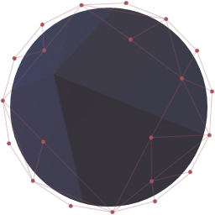
Facial Micro-Expression

Slide 15
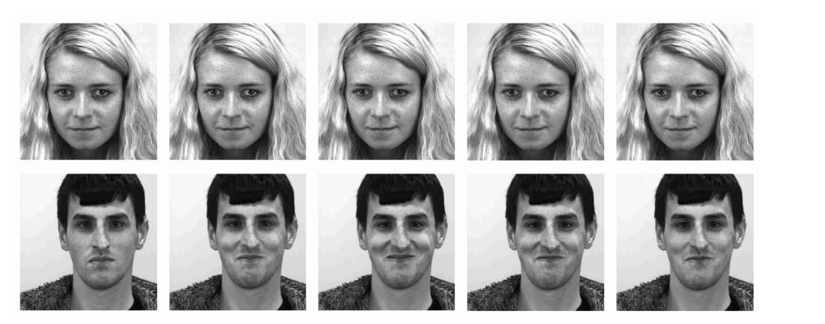
01
Definition
Micro-expression is a facial activity produced by
the unconscious contraction of facial muscles
under psychological inhibition.
Definition:
[2] The top is Microexpression, and the bottom is Macroexpression. It can be seen that the Macroexpression has a higher degree of discrimination. The micro expressions are relatively low in amplitude
Short duration (1/25 to 1/5s) and low action intensity,
it is difficult for humans to capture such information
Characteristic:
Notes:
[1] Haggard, E.A.; Isaacs, K.S. Micromomentary facial expressions as indicators of ego mechanisms in psychotherapy. In Methods of Research in Psychotherapy; Springer: Berlin/Heidelberg, Germany, 1966.
[2] Zhang, L. F. and O. Arandjelovic (2021). "Review of Automatic Microexpression Recognition in the Past Decade." Machine Learning and Knowledge Extraction 3(2): 414-434
[3] Zhang, M., Fu, Q., Chen, Y.-H., Fu, X.: Emotional context influences micro-expression recognition. PLoS ONE 9(4), e95018 (2014)

Slide 16
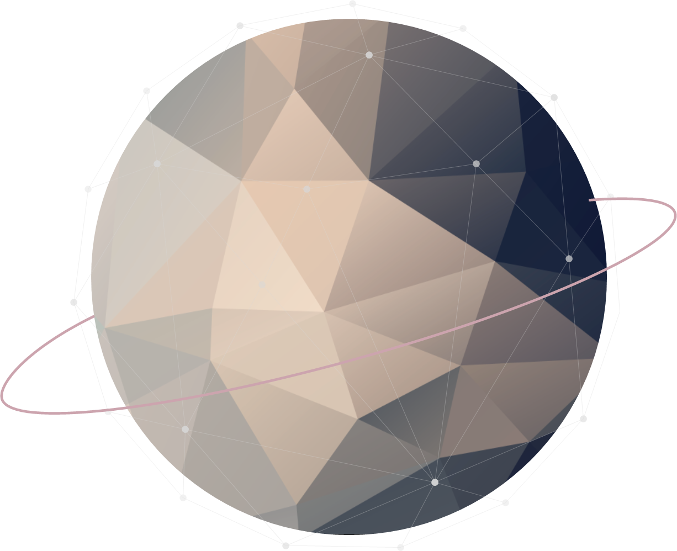

02
Value
Application 1
Lie detection
Since micro-expression is produced spontaneously when the brain is unconscious,
it is difficult for people to consciously generate or offset it
Application 2
Psychologist diagnostic assistance
Notes:
应用1

Slide 17
03
Datasets
1
CASME
2
SMIC
Due to the short duration of micro expressions,
we can only locate micro expressions through videos,
and It’s better high frame rate videos.
3
CASME
4
SAMM
Data Sets
5
CAS(ME)^2

Slide 18
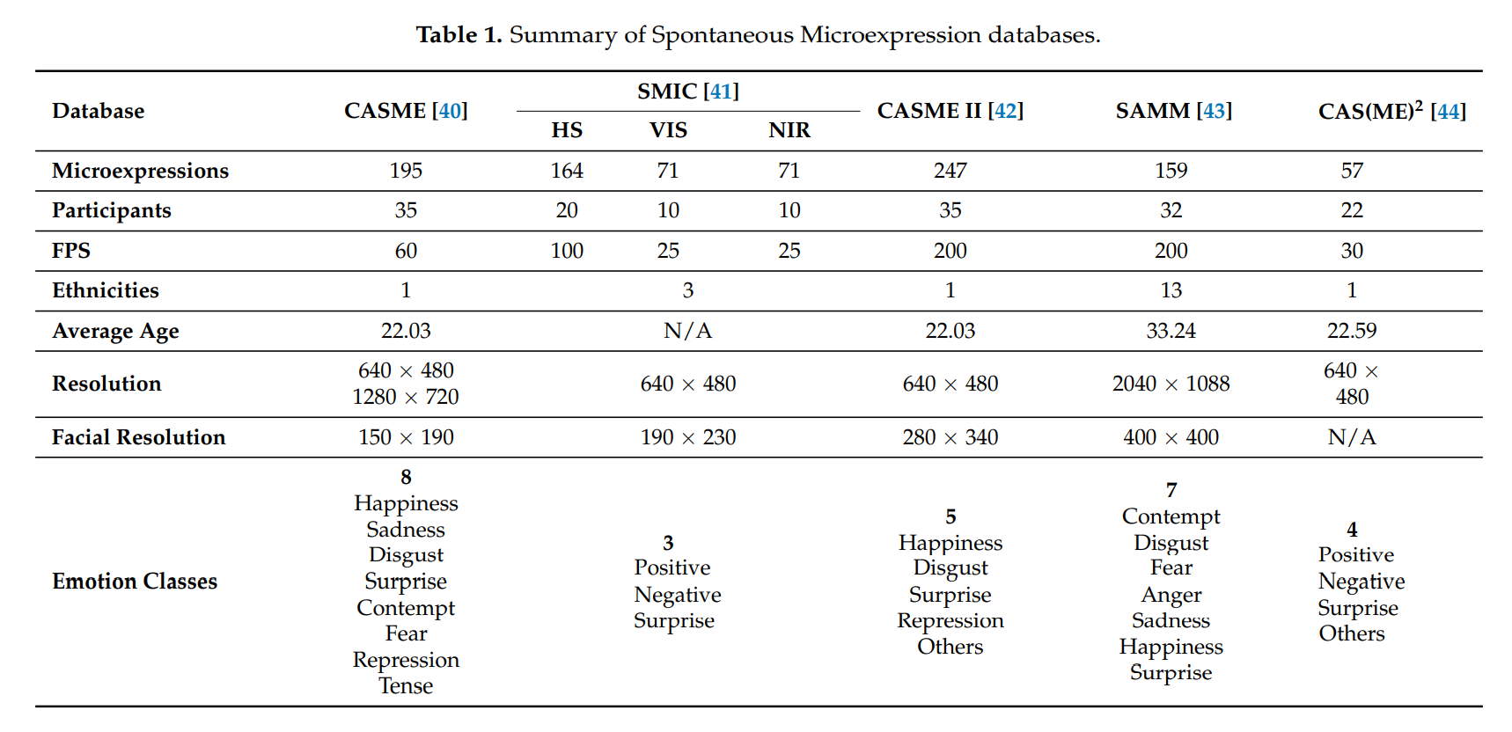
03
Datasets
Microexpression database comparison.[1]
They have main differences in the number of participants' race, video frame rate, and emotion classes. etc.
Notes:
[1] Zhang, L. F. and O. Arandjelovic (2021). "Review of Automatic Microexpression Recognition in the Past Decade." Machine Learning and Knowledge Extraction 3(2): 414-434.
我们选了三个数据库

Slide 19
Multimodal Emotion recognition

Slide 20
Problem, Value & Sensor
Problem
Accuracy Lose
The transfer of laboratory-controlled FER system to real-world application technology has low accuracy
Value
Improve accuracy
We use other sensors to provide additional information
1. Detailed-face sensors e.g. eye-trackers
2. Non-visual sensors e.g. EEG, audio
3. Target-focused sensors e.g. infrared thermal sensors
Sensor
Notes:
[1]
[2]
[3]

Slide 21

What we have done so far

Slide 22
CK+48 dataset
(https://www.kaggle.com/shawon10/ckplus)
The dataset contains 981 grayscale images(48*48) with 7 categories ('contempt', 'disgust', 'surprise', 'sadness', 'anger', 'fear', 'happy’ )

Slide 23
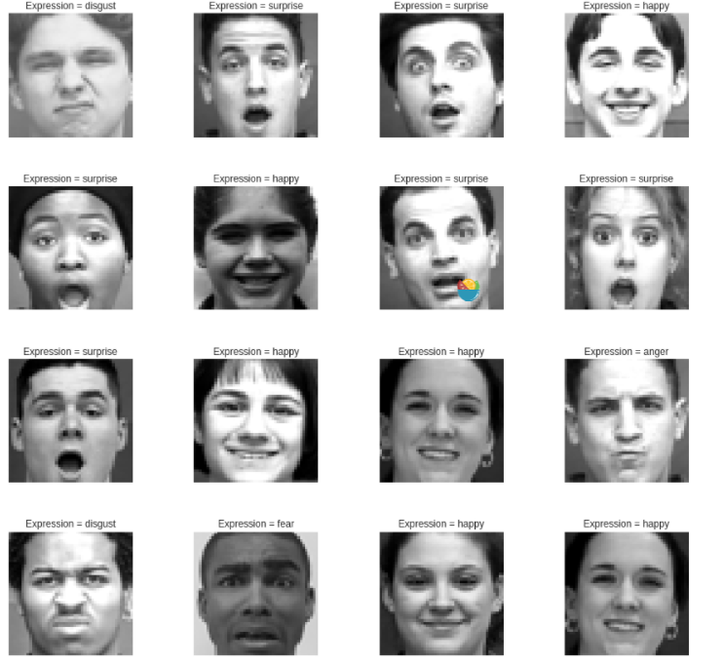
Random select 16 images to show

Slide 24
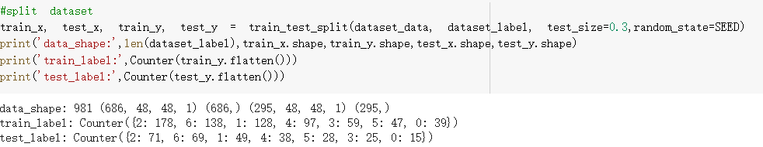
Split the dataset(7:3)
'contempt’: 54, 'disgust’: 177, 'surprise’: 249, 'sadness’: 84, 'anger’: 135, 'fear’: 75, 'happy’: 207
2. Data Augment and Feature Extraction
Resize(target_size=(128,128)),
RandomBlur(),
RandomHorizontalFlip(),
MixupImage(),
Normalize(),

Slide 25
3. Model- ResNet101_vd_ssld
1. Use pre-trained model from Image-1k dataset
2. Try the same model to do this task

Slide 26
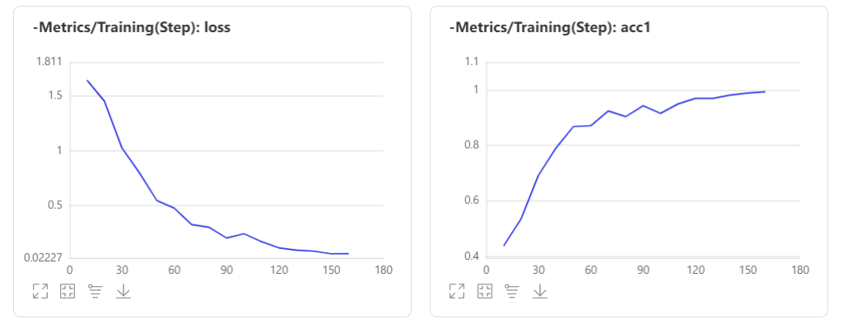
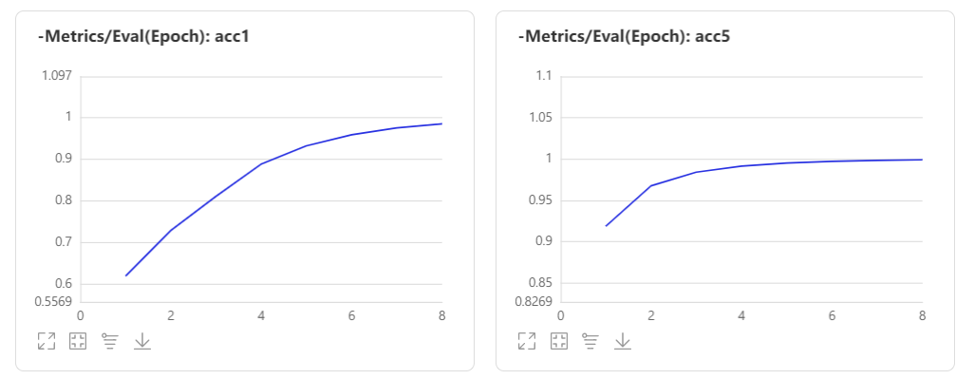
4. Results and Visualize

Slide 27
Then we try to use the same model in a bigger dataset
(xunfei facial emotion recognition competition)
trainset：2.8W；
testset：7K；( can not see just for competition)
Image: 48*48pixel。
Category:
angry
disgusted
fearful
happy
neutral
sad
surprised
The acc on the testset we got
Reference: https://challenge.xfyun.cn/topic/info?type=facial-emotion-recognition

Slide 28








Possible Improvement in the future
Data cleaning or try soft label
Cartoon face
Bad label

Slide 29
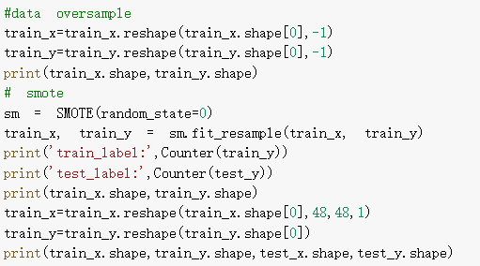
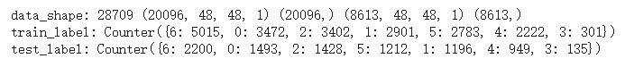
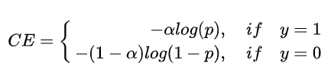
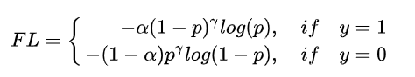
Deal with the imbalanced label
1. Data oversampling with smote
SMOTE works by utilizing a k-nearest neighbor algorithm to create synthetic data. SMOTE first start by choosing random data from the minority class, then k-nearest neighbors from the data are set. Synthetic data would then made between the random data and the randomly selected k-nearest neighbor.
2. Focal Loss
Reference: Chawla N V, Bowyer K W, Hall L O, et al. SMOTE: synthetic minority over-sampling technique[J]. Journal of artificial intelligence research, 2002, 16: 321-357.

Slide 30
Solution for multi-person
use object-detection first to generate the location of people’s head
2. then loop all the heads we detected and resize them for same input
3. use the facial recognition model we trained to do the classification

Slide 31
Object Detection Part
Dataset: SCUT-HEAD is a large-scale head detection dataset, including 4405 images labeled with 111251 heads.
Platform: Baidu AI Studio
Language: PaddlePaddle
Algorithm: YOLOv4
Best result: MAP(89.38%)
Reference: https://github.com/HCIILAB/SCUT-HEAD-Dataset-Release
Bochkovskiy A, Wang C Y, Liao H Y M. Yolov4: Optimal speed and accuracy of object detection[J]. arXiv preprint arXiv:2004.10934, 2020.

Slide 32
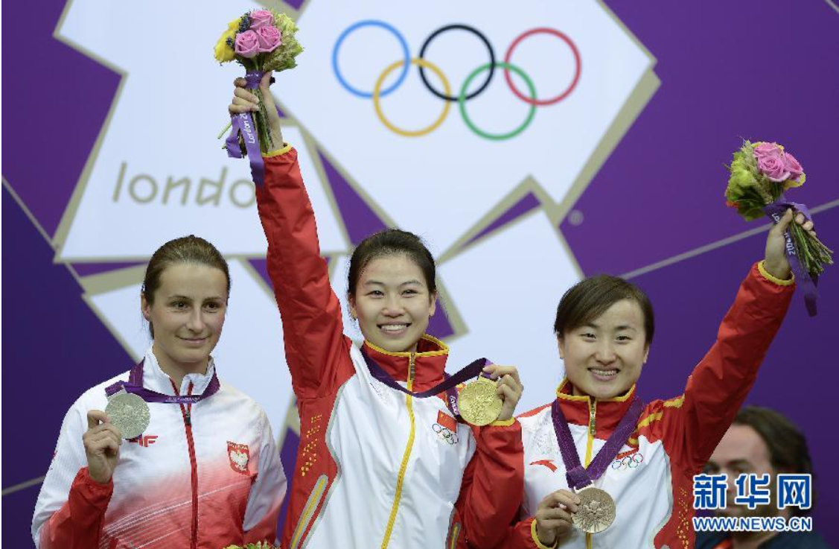
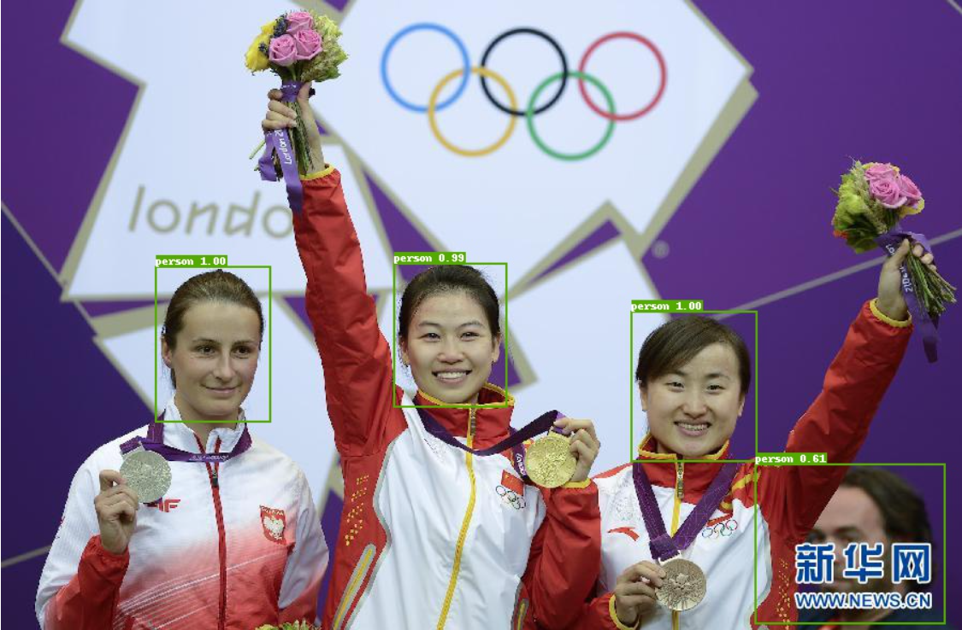
Original Image
Image with bounding box

Slide 33
Image Classification Part
From bbox we can know where the face is
Change RGB image to grayscale image
do classification

Slide 34
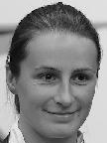
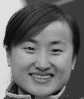

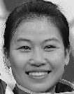
Grayscale images
Output Emotion:

Slide 35
Future Work
Train the baseline for facial micro-expression
Train the baseline for multimodal expression
Using tensorRT to prune the model and do Knowledge Distillation
deploy on a server and interface json
Use PYQT to do a simple GUI to do real-time stress detection
Possible Application
Using the emotion recognition model together with psychology chatbot to create a virtual psychological consultant.
Using the emotion recognition model to record the feelings/feedback of viewers when we are having ZOOM courses

Slide 36
Thank you for your attention

